Slide 1
Chapter 11: File System Implementation

Slide 2
Chapter 11: File System Implementation
File-System Structure
File-System Implementation
Directory Implementation
Allocation Methods
Free-Space Management
Efficiency and Performance
Recovery
Log-Structured File Systems
NFS
Example: WAFL File System

Slide 3
Objectives
To describe the details of implementing local file systems and directory structures
To describe the implementation of remote file systems
To discuss block allocation and free-block algorithms and trade-offs

Slide 4
File-System Structure
File structure
  Logical storage unit
  Collection of related information
File system resides on secondary storage (disks)
File system organized into layers
File control block – storage structure consisting of information about a file

Slide 5
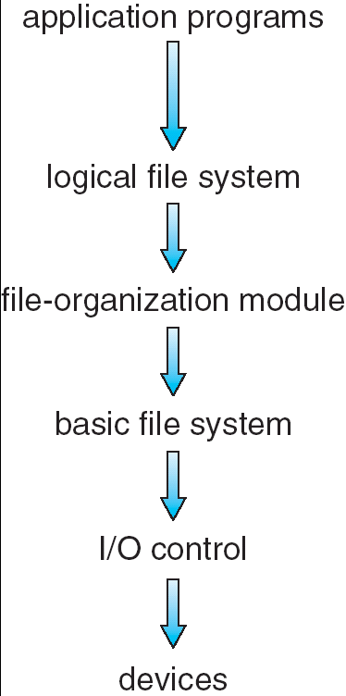
Layered File System

Slide 6
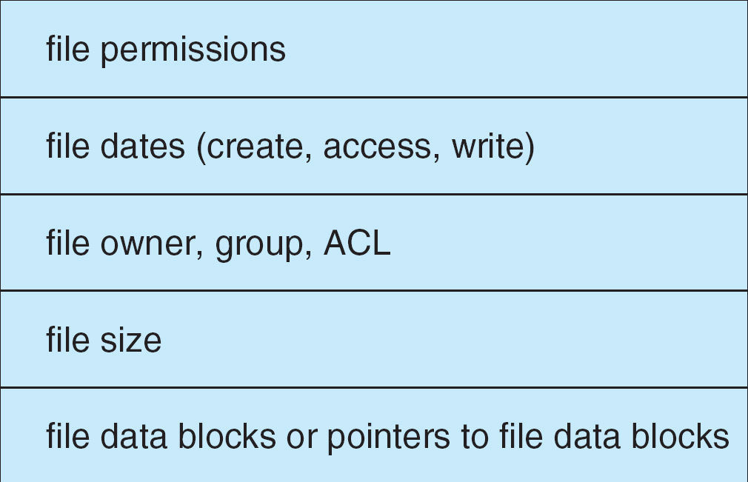
A Typical File Control Block

Slide 7
In-Memory File System Structures
The following figure illustrates the necessary file system structures provided by the operating systems.
Figure 12-3(a) refers to opening a file.
Figure 12-3(b) refers to reading a file.

Slide 8

In-Memory File System Structures

Slide 9
文件系统的常见类型
FAT文件系统（MS-DOS文件系统）
它是MS-DOS操作系统使用的文件系统，它也能由Windows98/NT、linux、SCO UNIX等操作系统访问。文件地址以FAT表结构存放，文件目录32B，文件名为8个基本名加上一个“.”和3个字符扩展名。
FAT32文件系统（vfat）
它是Windows98使用的扩展的DOS文件系统，它在MS-DOS文件系统基础上增加了对长文件名（最多到256B）支持。
NTFS（NT文件系统）
它是Windows NT操作系统使用的文件系统，它具有很强的安全特性和文件系统恢复功能，可以处理巨大的存储媒体，支持多种文件系统。
S51K/S52K（sysv）
它是AT&T UNIX S V 操作系统使用的文件系统。

Slide 10
文件系统的常见类型
ext2（二级扩展文件系统）
它是Linux操作系统使用的文件系统，它是对Minux操作系统中使用的文件系统扩展（ext）的扩展。它支持256字符的文件名，最大可支持到4TB的文件系统大小。
HPFS（高性能文件系统）
它是OS/2操作系统使用的文件系统。
CD-ROM文件系统(iso9660)
它是符合ISO9660标准的支持CD-ROM的文件系统，它有High sierra CD-ROM和Rock Ridge CD-ROM二种类型。
UDF通用磁盘格式文件系统
UDF(Universal Disk Format)文件系统是依据光学储存技术协会（Optical Storage Technology Association, OSTA）的通用磁盘格式文件系统规格1.02版所制定的。它提供了对 UDF格式媒体的只读访问（例如DVD光盘）。
不同类型文件系统的接口问题

Slide 11
Virtual File Systems
Virtual File Systems (VFS) provide an object-oriented way of implementing file systems.
VFS allows the same system call interface (the API) to be used for different types of file systems.
The API is to the VFS interface, rather than any specific type of file system.

Slide 12

Schematic View of Virtual File System

Slide 13
Directory Implementation
Linear list of file names with pointer to the data blocks.
  simple to program
  time-consuming to execute
Hash Table – linear list with hash data structure.
  decreases directory search time
  collisions – situations where two file names hash to the same location
  fixed size

Slide 14
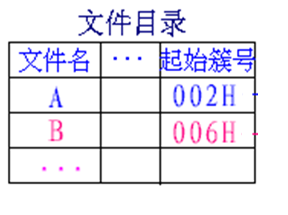
Windows FAT32目录结构——目录（FCB表）

Slide 15
Windows FAT32目录结构——目录项（FCB）
Windows98、2000长文件名的目录项由几个MS－DOS的32B目录项组成。
它用一个表项存放短文件名和这个文件或子目录的其它信息（包括MS－DOS FCB原有的簇号、文件大小，最后修改时间和最后修改日期，还有Windows98增加的创建时间、创建日期和最后存取日期），短文件名的属性是0×20。
用连续若干个表项存放长文件名，每个表项存放13个字符（使用Unicode编码，不论西文和汉字，每个字符一律占用2个字节。对西文第一个字节存ASCII码，第二个字节存0×00。）
长文件名的表项首字节的二进制数低5位值，分别为00001B 、00010B 、 00011B 、……，表示它们的次序，左起第2位为1（也就是在低5位基础上加40H）表示该表项是最后一项。最后项存放13个字符位置多余时，先用2个字节0表示结束，再用FFH填充。长文件名的属性是OFH。长文件名项的第13、27、28字节为0×00，第14字节为短文件名检验和。
长文件名The quick brown.fox（短文件名为THEQUI~1.FOX）目录项格式如下：

Slide 16
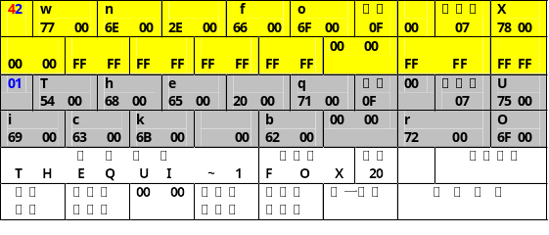
Windows FAT32目录结构——目录项（FCB）
共占了3个MSDOS的目录项

Slide 17
Windows FAT32目录结构——目录项（FCB）
用Debug工具查根目录区找出其目录项显示如下：
2171:29A0 42 77 00 6E 00 2E 00 66-00 6F 00 0F 00 07 78 00 Bw.n...f.o....x.
2171:29B0 00 00 FF FF FF FF FF FF-FF FF 00 00 FF FF FF FF ................
2171:29C0 01 54 00 68 00 65 00 20-00 71 00 0F 00 07 75 00 .T.h.e. .q....u.
2171:29D0 69 00 63 00 6B 00 20 00-62 00 00 00 72 00 6F 00 i.c.k. .b...r.o.
2171:29E0 54 48 45 51 55 49 7E 31-46 4F 58 20 00 3C C1 7B THEQUI~1FOX .<.{
2171:29F0 6E 26 7B 27 00 00 23 51-63 26 F4 09 00 6A 02 00 n&{'..#Qc&...j..

Slide 18
Allocation Methods
An allocation method refers to how disk blocks are allocated for files:
Contiguous allocation
Linked allocation
Indexed allocation

Slide 19
Contiguous Allocation
Each file occupies a set of contiguous blocks on the disk
Simple – only starting location (block #) and length (number of blocks) are required
Random access
Wasteful of space (dynamic storage-allocation problem)
Files cannot grow

Slide 20
Contiguous Allocation
Mapping from logical to physical
Q
LA/512
R
  Block to be accessed = ! + starting address
  Displacement into block = R

Slide 21

Contiguous Allocation of Disk Space

Slide 22
Extent-Based Systems
Many newer file systems (I.e. Veritas File System) use a modified contiguous allocation scheme
Extent-based file systems allocate disk blocks in extents
An extent is a contiguous block of disks
  Extents are allocated for file allocation
  A file consists of one or more extents.

Slide 23
Linked Allocation
Each file is a linked list of disk blocks: blocks may be scattered anywhere on the disk.
block =
pointer

Slide 24
Linked Allocation (Cont.)
Simple – need only starting address
Free-space management system – no waste of space
No random access
Mapping
Q
LA/511
R
  Block to be accessed is the Qth block in the linked chain of blocks representing the file.
  Displacement into block = R + 1
File-allocation table (FAT) – disk-space allocation used by MS-DOS and OS/2.

Slide 25
Linked Allocation
文件目录
文件名 始址 末址
0
1
10
2
3
jeep 9 25
4
5
6
7
8
9
16
10
25
11
12
13
14
15
16
1
17
18
19
20
21
22
23
24
25
-1
26
27
28
29
30
31

Slide 26

File-Allocation Table

Slide 27
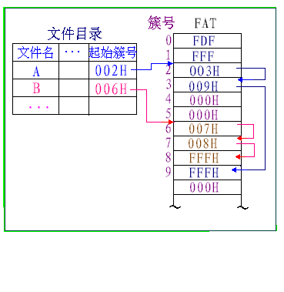

Slide 28
关于FAT的问题
FAT文件系统中的文件是一种链接结构？
  是链接结构（有链接结构的优点），其链指针单独用FAT表存放
FAT中的文件只能顺序访问？为什么？
  既能顺序访问，又能直接访问。因为FAT表不大，相关文件的链接信息可以大部或全部读入内存，并且是分很少几次读入内存的

Slide 29
Indexed Allocation
Brings all pointers together into the index block.
Logical view.
index table

Slide 30

Example of Indexed Allocation

Slide 31
Indexed Allocation (Cont.)
Need index table
Random access
Dynamic access without external fragmentation, but have overhead of index block.
Mapping from logical to physical in a file of maximum size of 256K words and block size of 512 words. We need only 1 block for index table.
Q
LA/512
R
Q = displacement into index table
R = displacement into block

Slide 32
Indexed Allocation – Mapping (Cont.)
Mapping from logical to physical in a file of unbounded length (block size of 512 words).
Linked scheme – Link blocks of index table (no limit on size).
Q₁
LA / (512 x 511)
R₁
  Q₁ = block of index table
  R₁ is used as follows:
Q₂
R₁ / 512
R₂
  Q₂ = displacement into block of index table
  R₂ displacement into block of file:

Slide 33
Indexed Allocation – Mapping (Cont.)
Two-level index (maximum file size is 512³)
Q₁
LA / (512 x 512)
R₁
  Q₁ = displacement into outer-index
  R₁ is used as follows:
Q₂
R₁ / 512
R₂
  Q₂ = displacement into block of index table
  R₂ displacement into block of file:

Slide 34
Indexed Allocation – Mapping (Cont.)

outer-index
index table
file

Slide 35
综合模式:UFS中使用的方案
UNIX、Linux直接间接混合分配方法(综合模式)。
由于80％以上的文件是小文件，为了解决能高速存取小文件和管理大文件的矛盾，UNIX将直接寻址、一级索引、二级索引和三级索引结合起来，形成混合寻址方式，如下图所示。
在UNIX S V的索引结点中设有13个地址项di_addr[13]（Linux的ext2设有15个地址项）它们把所存的地址项分成两类，其中最后三个地址项分别是一级索引、二级索引和三级索引的指针，而前面10个（ext2为12个）为直接寻址的地址项，即存放文件逻辑块第0－9/11块的盘块号。
如每个盘块大小为4KB时，当文件不大于40KB时，便可直接从索引结点中读出该文件全部盘块号，这样读小文件时速度快；如文件大于 40KB时，系统再逐步增加一级索引、二级索引和三级索引，这样最大管理的文件为40KB＋4MB＋4GB＋4TB，达到管理大文件的目标。

Slide 36

Combined Scheme: UNIX (4K bytes per block)

Slide 37
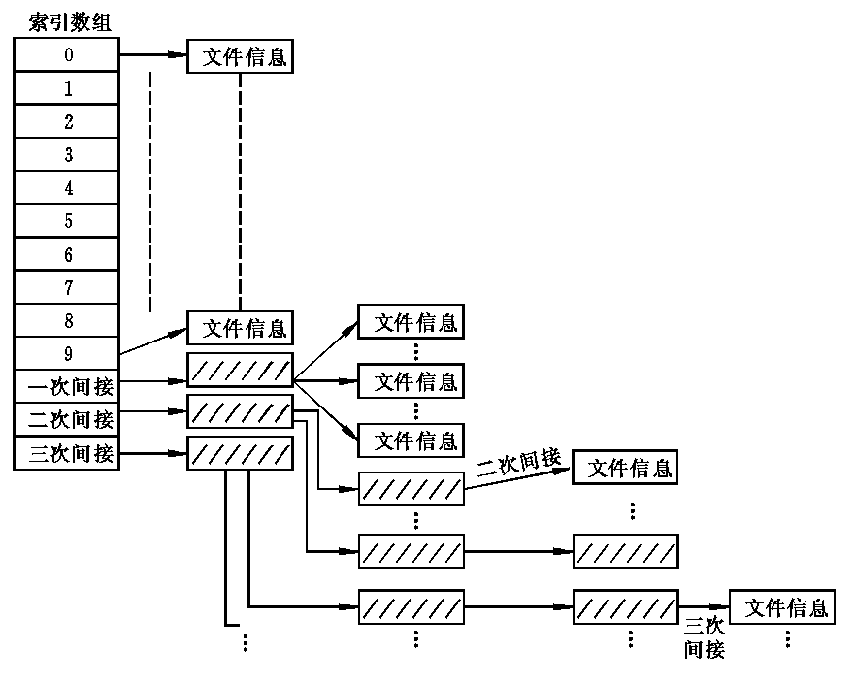
Linux中的磁盘索引结点中的文件地址（索引）
索引结点（i结点）

Slide 38
13个物理块长=6．5K。
文件分为
小型——长度小于5K
中型——长度大于5K但小于90K
大型——长度大于90K但小于14.54M
巨型——长度大于14.54M，共10+170+170*170+170*170*170=4942080块

Slide 39
Free-Space Management
Bit vector (n blocks)
0
1
2
n-1
…
0 ⇒ block[i] free
1 ⇒ block[i] occupied
bit[i] =

Block number calculation
(number of bits per word) *
(number of 0-value words) +
offset of first 1 bit

Slide 40
Free-Space Management (Cont.)
Bit map requires extra space
  Example:
block size = 2¹² bytes
disk size = 2³⁰ bytes (1 gigabyte)
n = 2³⁰/2¹² = 2¹⁸ bits (or 32K bytes)
Easy to get contiguous files
Linked list (free list)
  Cannot get contiguous space easily
  No waste of space
Grouping
Counting

Slide 41
Free-Space Management (Cont.)
Need to protect:
  Pointer to free list
  Bit map
    Must be kept on disk
    Copy in memory and disk may differ
    Cannot allow for block[i] to have a situation where bit[i] = 1 in memory and bit[i] = 0 on disk
  Solution:
    Set bit[i] = 1 in disk
    Allocate block[i]
    Set bit[i] = 1 in memory

Slide 42

Linked Free Space List on Disk

Slide 43
UNIX 成组链接法
UNIX S V操作系统采用成组链接法管理磁盘空闲块，该方法是空闲表法和空闲块链接法的结合，具备分配回收方便，不需专用块来存放分配表等优点。
成组链接法将磁盘空闲块分成若干组，如将每100个盘块作为一组，该组空闲块总数和各空闲块块号存入下一组的第一个空闲块中。最后不满100块的那组空闲块总数和各空闲块块号记入磁盘区专用管理块的空闲块管理的数据结构：s_nfree和s_free[100]中，如下图所示。

Slide 44
成组链接法-1
    盘专用管理块
s_nfree
0
1
s_free[100] 449块
38
50块 150块 350块
99
49块 149块
12块 51块 251块 351块
100
150
149
.
.
.
51
100
.
.
.
.
.
.
.
.
100
0
499
.
.
.
351
39
50
49
.
12

Slide 45
成组链接法-2
磁盘专用管理块中s_free[100]作为空闲块栈，而s_nfree作为空闲块栈指针，用于空闲块的分配和回收。
在要分配一个空闲块时，只要先按空闲块栈指针s_nfree到空闲块栈中取表目为s_free[s_nfree]的盘块号分配，再将s_nfree存数减1，即弹出栈。
当要回收一块空闲块时，则先将栈指针s_nfree存数加1，再将回收的空闲块号存入空闲块栈s_free[s_nfree]表目中，即压入栈。
当空闲块栈分配完或回收满时分配和回收操作复杂点:
  当栈中最后一块要分配出去时，先将该块内容读入栈中，再将该块分配出去；
  回收时，当发现栈中已有100个块号，则将这些块号写入当前回收块中，并将栈清空，当前回收的块号入栈。
由于文件系统要安装时，磁盘专用块拷入内存系统缓冲区，所以成组链接法分配和回收操作大部分情况只与内存进行读写，所以速度较快。

Slide 46
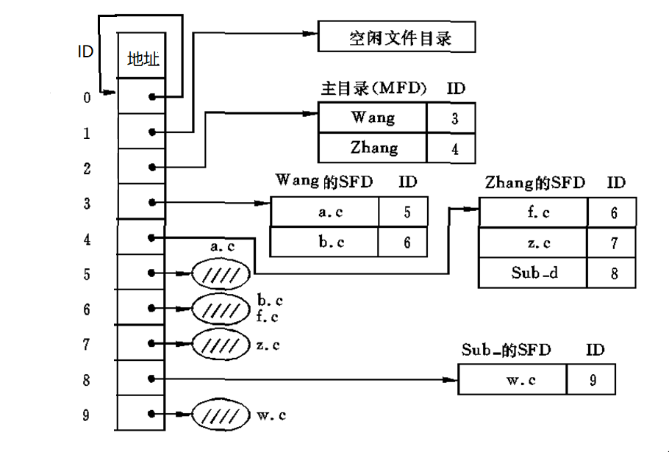
UNIX(Linux)的目录结构
基本文件目录
(BFD)——i节点表

Slide 47
Unix目录结构的优点
便于共享
检索速度快
例子：一个目录项(FCB)有48个字节
符号目录项占 8字节
文件名6字节，文件号2字节
基本目录项占 48-6=42字节
假设，物理块大小512字节

Slide 48
解：分解前：占512/48=10个FCB
分解后：占512/8=64个符号目录项或512/42=12个基本目录项
假设：目录文件有128个目录项
分解前：占13块
分解后：符号文件占2块
基本文件占11块

Slide 49
查找一个文件的平均访盘次数——不包括对MFD的访问，即从UFD(用户文件目录)或SFD（符号文件目录）开始计算
分解前：对UFD的平均访盘数=(1+n)/2=(1+13)/2=7次
分解后：对SFD的平均访盘数+对BFD的访盘数= (1+n)/2+1=(1+2)/2 +1 =2.5次
减少了访问硬盘的次数，提高了检索速度

Slide 50
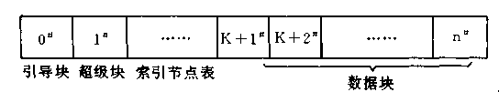
UNIX(LINUX)文件卷存储结构
超级块——文件资源表——专用块
索引节点表——基本文件目录(BFD)

Slide 51
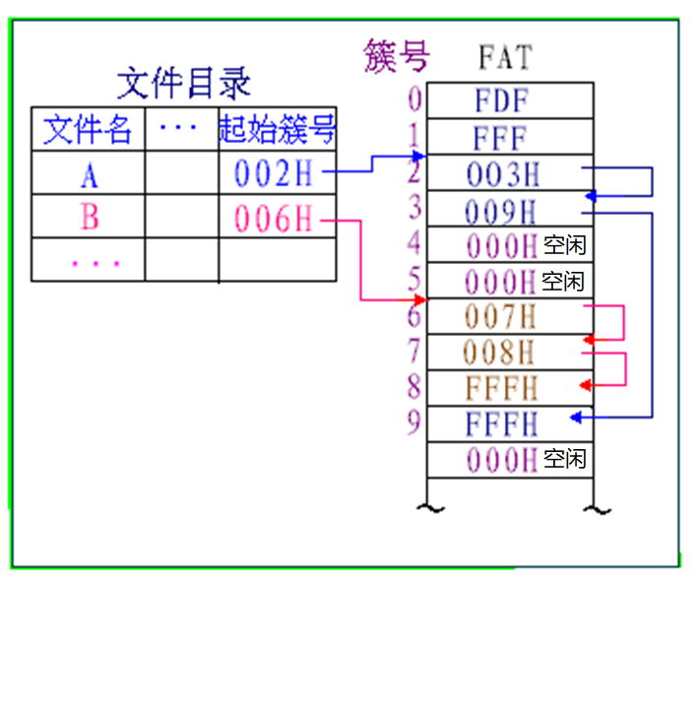
Windows的FAT文件及文件目录结构

Slide 52
FAT文件卷存储结构
引导区 | 文件分配表1 | 文件分配表2 | 根目录 | 其他
FAT12和FAT16仅预留了存储256个目录项的根目录空间（根目录区在固定位置）
  FAT32根目录区不是固定位置的，它是存放在数据区的根目录文件，文件数不受限制
文件分配表2是文件分配表1的备份
其他：存放其他目录和文件的数据区

Slide 53
Efficiency and Performance
Efficiency dependent on:
  disk allocation and directory algorithms
  types of data kept in file’s directory entry（文件的目录项）
Performance
  disk cache – separate section of main memory for frequently used blocks
  free-behind(马上释放) and read-ahead(预读) – techniques to optimize sequential access
  improve PC performance by dedicating section of memory as virtual disk, or RAM disk

Slide 54
Page Cache
A page cache caches pages rather than disk blocks using virtual memory techniques
Memory-mapped I/O uses a page cache
Routine I/O through the file system uses the buffer (disk) cache
This leads to the following figure

Slide 55
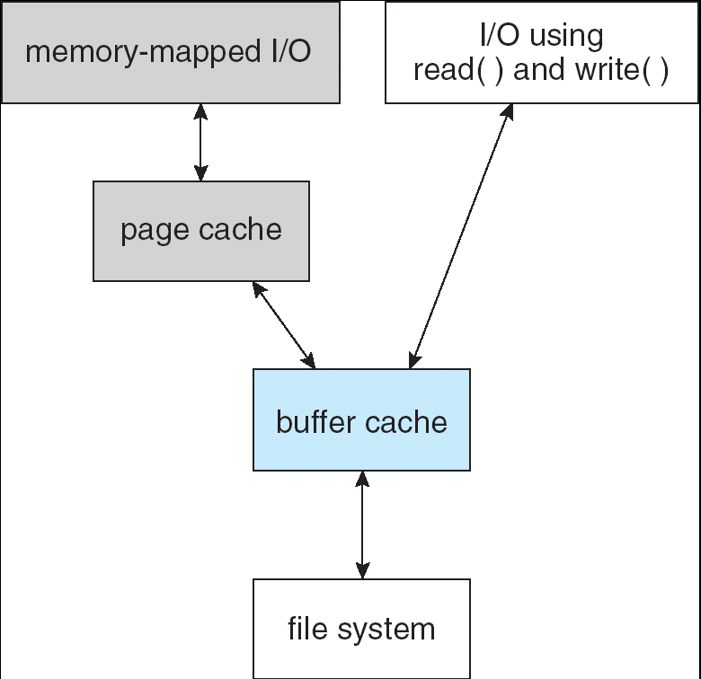
I/O Without a Unified Buffer Cache

Slide 56
Unified Buffer Cache
A unified buffer cache uses the same page cache to cache both memory-mapped pages and ordinary file system I/O

Slide 57
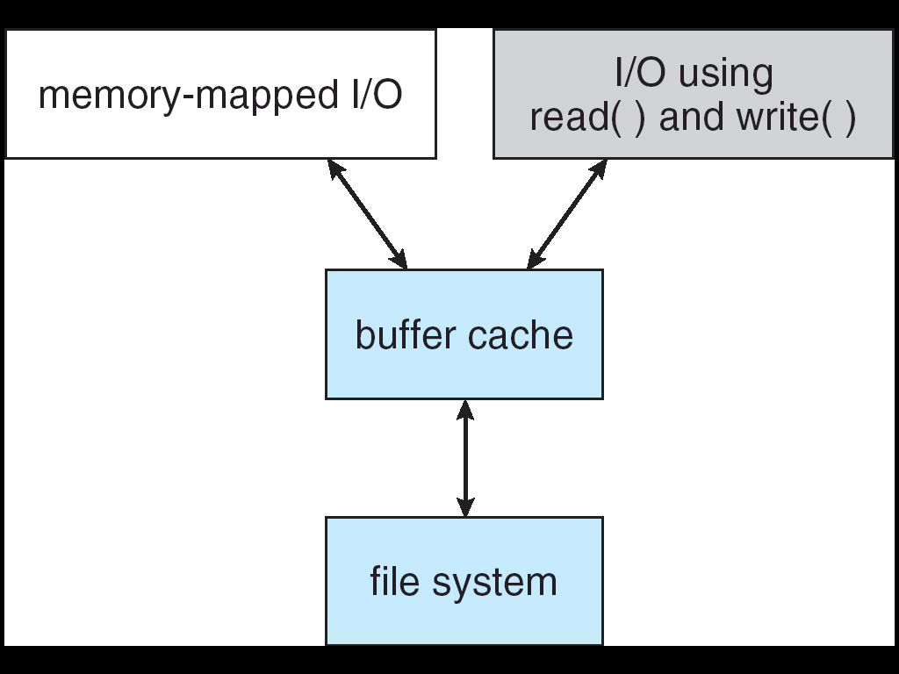
I/O Using a Unified Buffer Cache

Slide 58
Recovery
Consistency checking – compares data in directory structure with data blocks on disk, and tries to fix inconsistencies
Use system programs to back up data from disk to another storage device (floppy disk, magnetic tape, other magnetic disk, optical)
Recover lost file or disk by restoring data from backup

Slide 59
Log Structured File Systems
Log structured (or journaling) file systems record each update to the file system as a transaction
All transactions are written to a log
  A transaction is considered committed once it is written to the log
  However, the file system may not yet be updated
The transactions in the log are asynchronously written to the file system
  When the file system is modified, the transaction is removed from the log
If the file system crashes, all remaining transactions in the log must still be performed

Slide 60
The Sun Network File System (NFS)
An implementation and a specification of a software system for accessing remote files across LANs (or WANs)
The implementation is part of the Solaris and SunOS operating systems running on Sun workstations using an unreliable datagram protocol (UDP/IP protocol and Ethernet

Slide 61
NFS (Cont.)
Interconnected workstations viewed as a set of independent machines with independent file systems, which allows sharing among these file systems in a transparent manner
  A remote directory is mounted over a local file system directory
    The mounted directory looks like an integral subtree of the local file system, replacing the subtree descending from the local directory
  Specification of the remote directory for the mount operation is nontransparent; the host name of the remote directory has to be provided
    Files in the remote directory can then be accessed in a transparent manner
  Subject to access-rights accreditation, potentially any file system (or directory within a file system), can be mounted remotely on top of any local directory

Slide 62
NFS (Cont.)
NFS is designed to operate in a heterogeneous environment of different machines, operating systems, and network architectures; the NFS specifications independent of these media
This independence is achieved through the use of RPC primitives built on top of an External Data Representation (XDR) protocol used between two implementation-independent interfaces
The NFS specification distinguishes between the services provided by a mount mechanism and the actual remote-file-access services

Slide 63

Three Independent File Systems

Slide 64
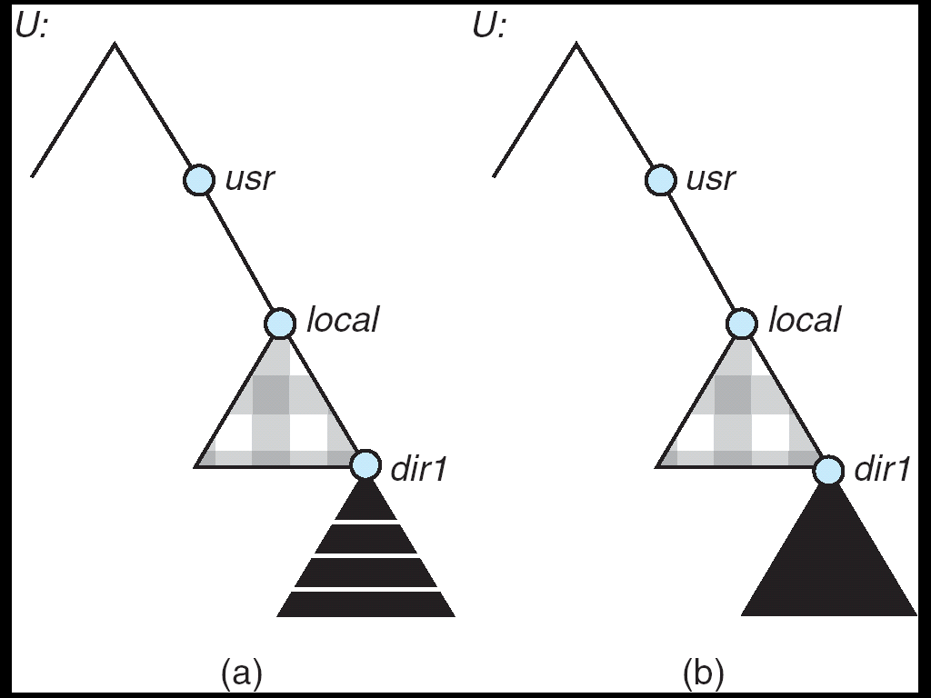
Mounting in NFS
Mounts
Cascading mounts

Slide 65
NFS Mount Protocol
Establishes initial logical connection between server and client
Mount operation includes name of remote directory to be mounted and name of server machine storing it
  Mount request is mapped to corresponding RPC and forwarded to mount server running on server machine
  Export list – specifies local file systems that server exports for mounting, along with names of machines that are permitted to mount them
Following a mount request that conforms to its export list, the server returns a file handle—a key for further accesses
File handle – a file-system identifier, and an inode number to identify the mounted directory within the exported file system
The mount operation changes only the user’s view and does not affect the server side

Slide 66
NFS Protocol
Provides a set of remote procedure calls for remote file operations. The procedures support the following operations:
  searching for a file within a directory
  reading a set of directory entries
  manipulating links and directories
  accessing file attributes
  reading and writing files
NFS servers are stateless; each request has to provide a full set of arguments
(NFS V4 is just coming available – very different, stateful)
Modified data must be committed to the server’s disk before results are returned to the client (lose advantages of caching)
The NFS protocol does not provide concurrency-control mechanisms

Slide 67
Three Major Layers of NFS Architecture
UNIX file-system interface (based on the open, read, write, and close calls, and file descriptors)
Virtual File System (VFS) layer – distinguishes local files from remote ones, and local files are further distinguished according to their file-system types
  The VFS activates file-system-specific operations to handle local requests according to their file-system types
  Calls the NFS protocol procedures for remote requests
NFS service layer – bottom layer of the architecture
  Implements the NFS protocol

Slide 68
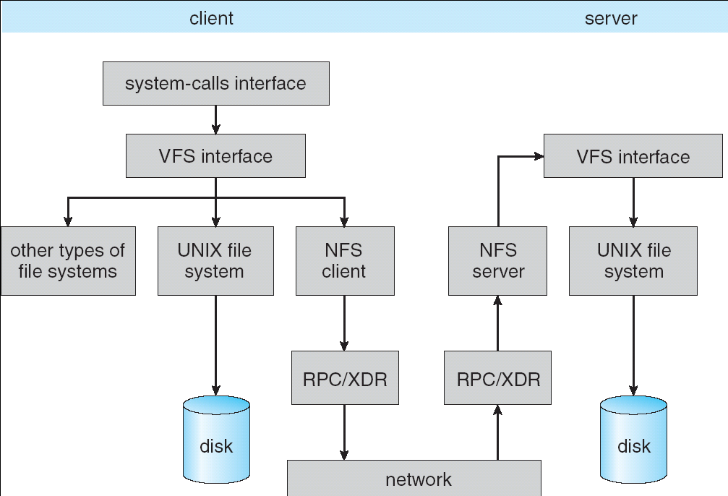
Schematic View of NFS Architecture

Slide 69
NFS Path-Name Translation
Performed by breaking the path into component names and performing a separate NFS lookup call for every pair of component name and directory vnode
To make lookup faster, a directory name lookup cache on the client’s side holds the vnodes for remote directory names

Slide 70
NFS Remote Operations
Nearly one-to-one correspondence between regular UNIX system calls and the NFS protocol RPCs (except opening and closing files)
NFS adheres to the remote-service paradigm, but employs buffering and caching techniques for the sake of performance
File-blocks cache – when a file is opened, the kernel checks with the remote server whether to fetch or revalidate the cached attributes
  Cached file blocks are used only if the corresponding cached attributes are up to date
File-attribute cache – the attribute cache is updated whenever new attributes arrive from the server
Clients do not free delayed-write blocks until the server confirms that the data have been written to disk

Slide 71
Example: WAFL File System
Used on Network Appliance “Filers” – distributed file system appliances
“Write-anywhere file layout”
Serves up NFS, CIFS, http, ftp
Random I/O optimized, write optimized
  NVRAM for write caching
Similar to Berkeley Fast File System, with extensive modifications

Slide 72
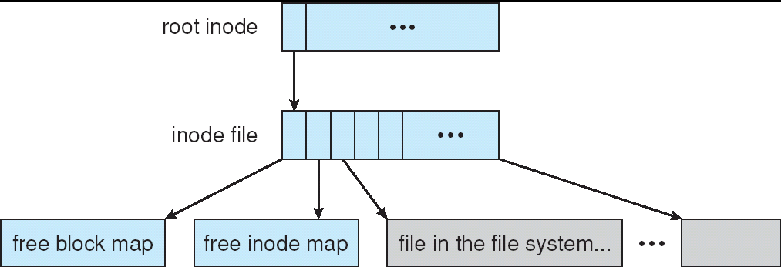
The WAFL File Layout

Slide 73
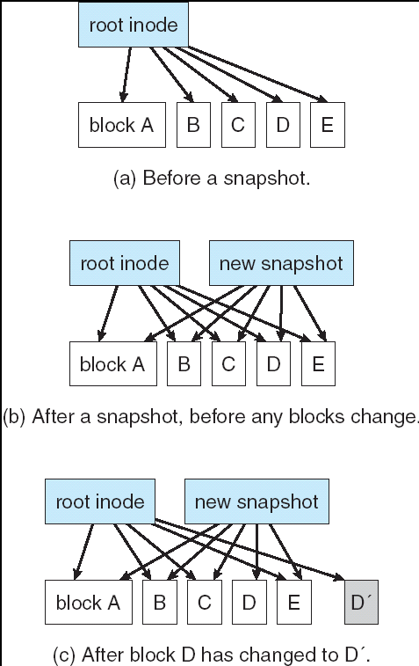
Snapshots in WAFL

Slide 74
11.02

Slide 75
End of Chapter 11

